Slide 1
VIGA
Vision-as-Inverse-Graphics Agent
Iterative Generate / Render / Verify Loop using VLMs + Blender
Project Summary | January - February 2026

Slide 2
Overall Pipeline Flow
Architecture
Iterative Pipeline
VIGA (top level)
Video-to-3D reconstruction
Dual-agent: Generator + Verifier
SAM3D (core module)
Image + Mask -> 3D GLB
Uses TRELLIS architecture
TRELLIS (Microsoft)
Sparse structure sampling
Dual decoder (GS + Mesh)
Meshy (asset library)
Text -> 3D GLB generation
Local fuzzy matching cache
1. Input
2. SAM3D Init
3. Generator
Target image/video + text description
Segment objects Reconstruct GLBs
Write Blender Python Import GLBs, compose
4. Blender
5. Verifier
6. Iterate
Execute script Render frames
VLM evaluates render vs target
Feedback loop until approved

Slide 3
Environment Setup
Windows 11 (Primary)
Linux / WSL2 (Tested)
OS: Windows 11 Home 10.0.26200
GPU: NVIDIA RTX 5080 16GB VRAM
CPU: AMD Ryzen 9 9900X | 32GB DDR5-6000
Conda Env: agent (Python 3.10)
openai 2.6.1 | mcp 1.20.0
pillow 12.0 | numpy 2.2.6
python-pptx 1.0.2
Conda Env: sam (Python 3.10)
torch 2.10.0+cu128 (CUDA 12.8)
torchvision 0.25.0+cu128
segment-anything 1.0 (Meta SAM)
opencv-python 4.13.0
Blender 4.5
EEVEE (BLENDER_EEVEE_NEXT)
Cycles GPU rendering
WSL2 Ubuntu (SAM3D testing)
CUDA passthrough from host GPU
~30% faster SAM3D inference
Higher VRAM efficiency
Windows Compatibility Fixes:
Path resolution: .resolve() all Paths
Pipe deadlock: temp files (not pipes)
Encoding: always utf-8 (not cp1252)
Spaces in paths: quote subprocess args
VLM Model: GPT-5 (OpenAI API)
Generator: writes Blender Python
Verifier: evaluates renders vs target
3D Asset Sources:
SAM3D: image -> 3D mesh (TRELLIS)
Meshy: text -> 3D mesh (API + cache)

Slide 4
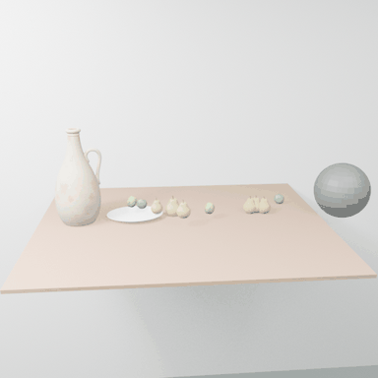
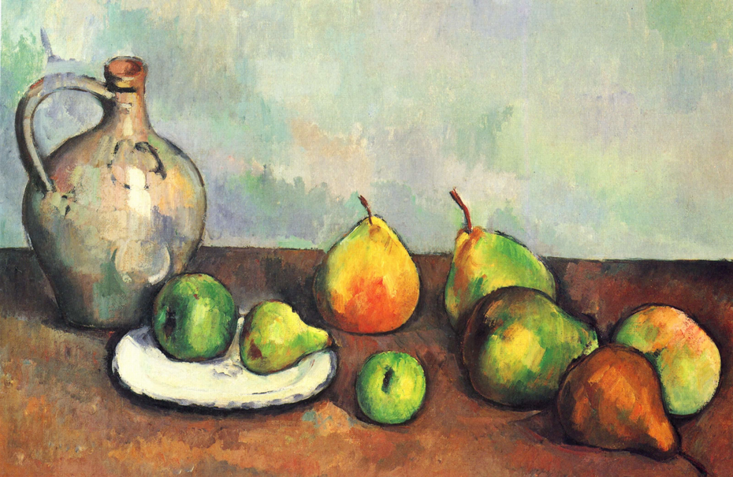
2026-02-11 — Dynamic Scene: Artist Run 2 (SAM3D Fixed)
kingyy (win/vscode/opus/hum) | Run
SAM3D injection bug fixed. Pre-computed GLBs loaded via --sam3d-results. Generator kept 5/8 SAM3D objects (fruits), replaced jug/plate/pear with Meshy cache. 50% faster than Run 1 (99 min vs 203 min). 21 rounds.
Input / Target
Output / Result

Slide 5

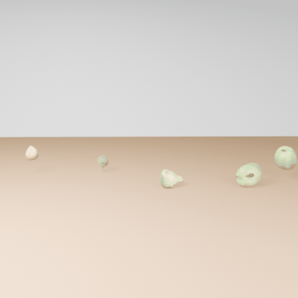
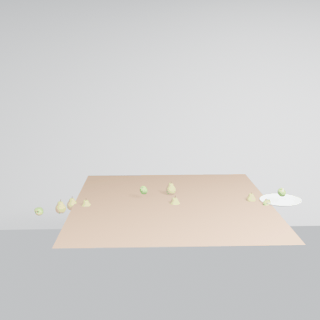
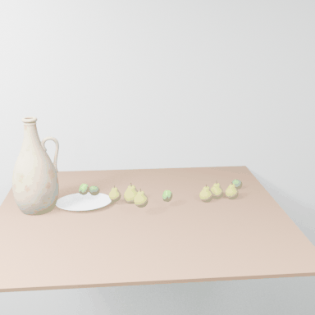
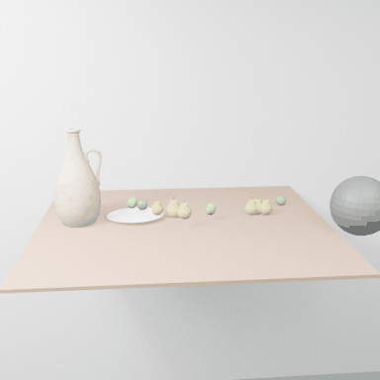
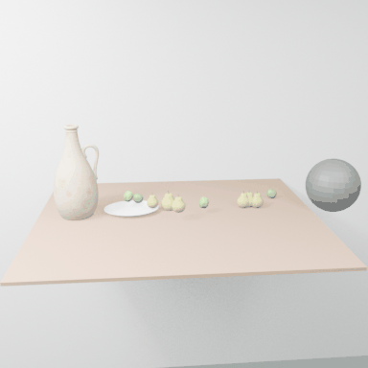
2026-02-11 — Dynamic Scene: Artist Run 2 (SAM3D Fixed) — Rounds (page 1)
R2 First SAM3D Import
R4 Objects on Table
R5 SAM3D+Meshy Mix
R15 Best Static
R16 Ball Added
R17 Ball Impact (360)

Slide 6

2026-02-11 — Dynamic Scene: Artist Run 2 (SAM3D Fixed) — Rounds (page 2)
R19 Rotation (360)
R19 Animation (180f)

Slide 7
2026-02-10 — SAM3D+Meshy Combined Pipeline Design
kingyy (win/vscode/opus/hum) | Analysis
Technical design for combining SAM3D reconstruction with Meshy text-to-3D. SAM3D initializes scene from target image, Meshy replaces poor-quality objects.
Combined flow: SAM3D auto-init -> segment target -> reconstruct GLBs
Generator receives SAM3D object paths in memory context
Phase 1: Render SAM3D scene, evaluate each object quality
Phase 1: Call get_better_object (Meshy) for poor objects only
Phase 2: Compose scene with best GLBs (SAM3D or Meshy mix)
Code changes to generator.py: capture SAM3D results, inject into memory
New prompt: get_asset_sam3d (three-phase workflow)
Bug fixes: kaolin DLL error, pipeline.yaml path resolution
Conda env mapping: sam env for SAM3D, agent env for Generator

Slide 8
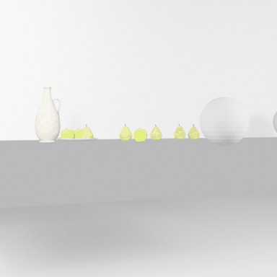
2026-02-10 — Dynamic Scene: Artist Run 1 (SAM3D + Meshy)
kingyy (win/vscode/opus/hum) | Run
First SAM3D-initialized dynamic scene. 8 objects reconstructed but injection bug (generator.py:81) meant Generator never received paths — replaced ALL with Meshy. Ball physics too subtle. 18 rounds, 203 min.
Input / Target
Output / Result

Slide 9
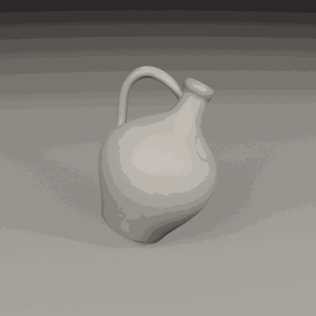
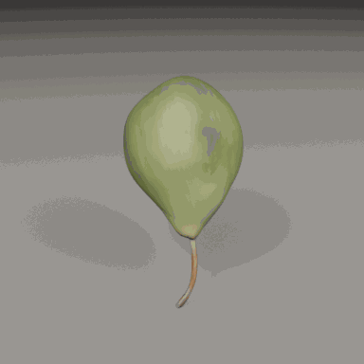
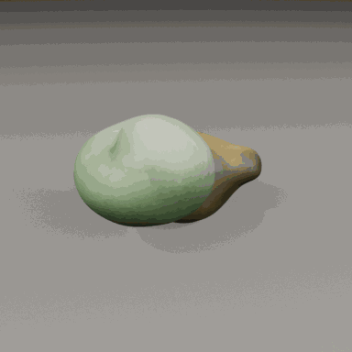
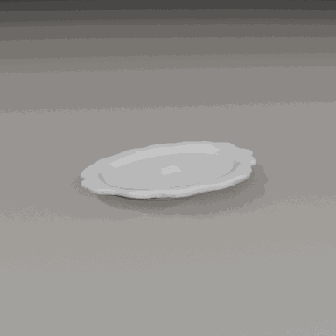
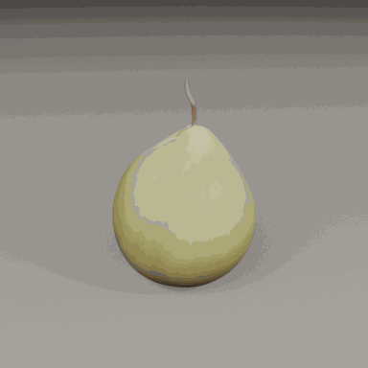
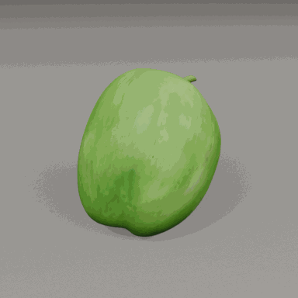
2026-02-10 — Dynamic Scene: Artist Run 1 (SAM3D + Meshy) — Rounds (page 1)
SAM3D: Ceramic Jug
SAM3D: Green Pears
SAM3D: Orange Pears
SAM3D: Plate+Fruits
SAM3D: Orange Pear
SAM3D: Green Apple

Slide 10
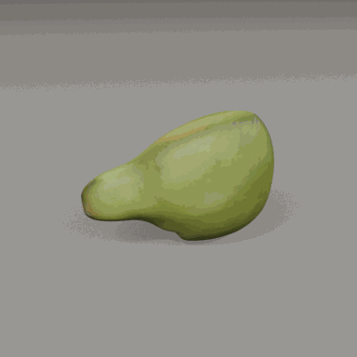
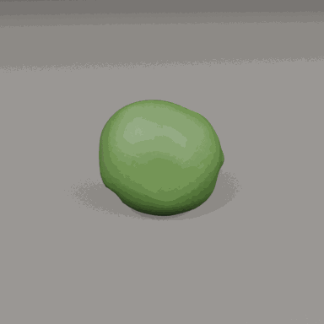
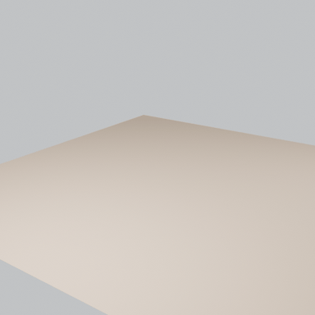
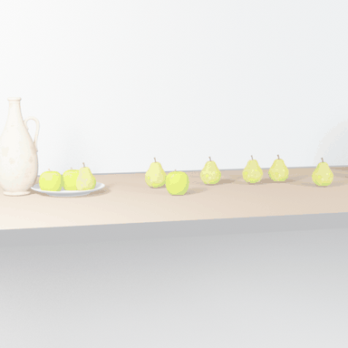
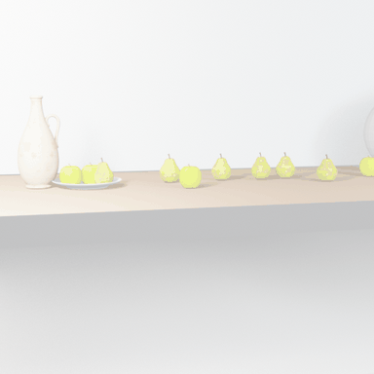
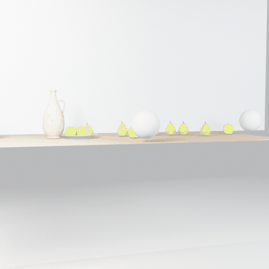
2026-02-10 — Dynamic Scene: Artist Run 1 (SAM3D + Meshy) — Rounds (page 2)
SAM3D: Green Pear
SAM3D: Green Apple 2
R2 First Render
R9 Scene Refinement
R14 Best Static
R16 Ball Added (360)

Slide 11
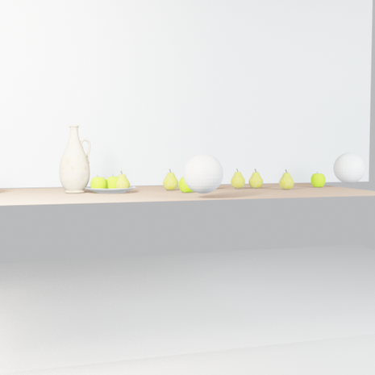
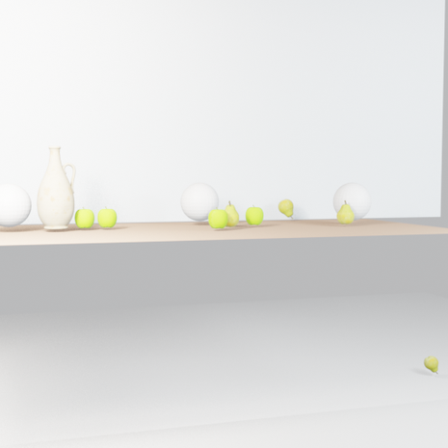
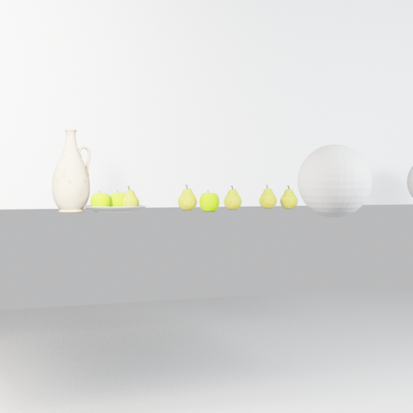
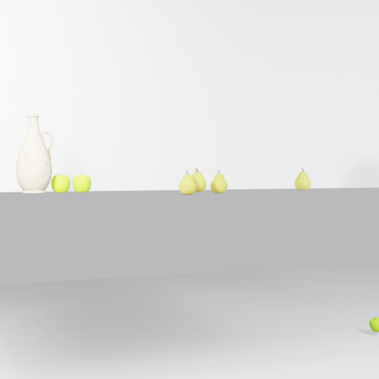
2026-02-10 — Dynamic Scene: Artist Run 1 (SAM3D + Meshy) — Rounds (page 3)
R16 Frame 1
R16 Frame 320
R18 Final (360)
R18 Frame 1
R18 Frame 260
R18 Frame 520

Slide 12
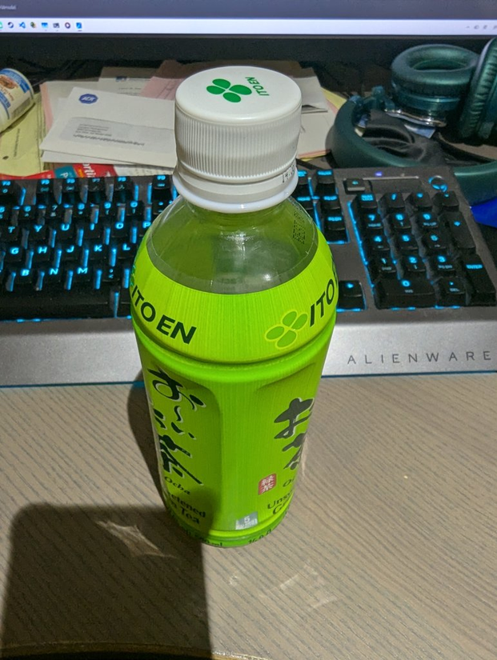
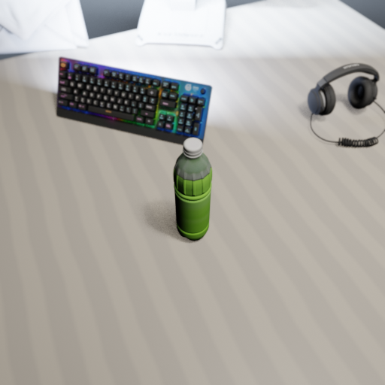
2026-02-10 — SAM3D+Meshy Static Scene Run 1
kingyy (win/vscode/opus/hum) | Run
First combined SAM3D+Meshy static scene. SAM3D reconstructed 6 objects but Generator replaced all with Meshy (4 cached, 1 new API). 25 rounds, 2h14m.
Input / Target
Output / Result

Slide 13


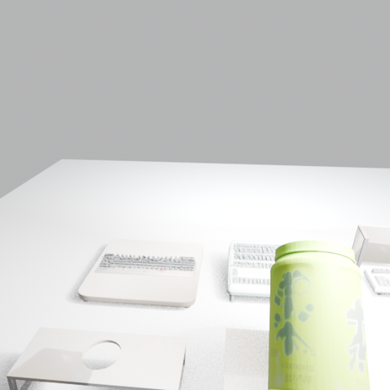
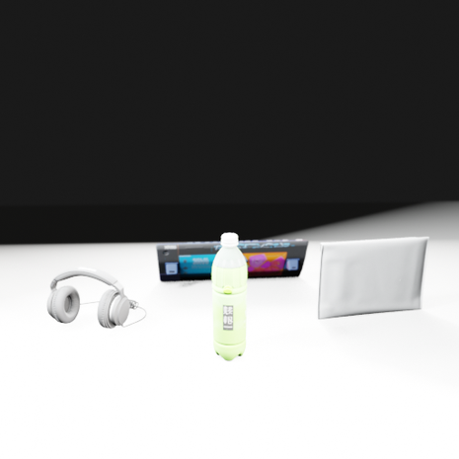
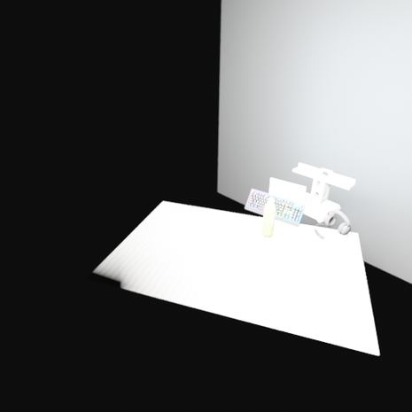
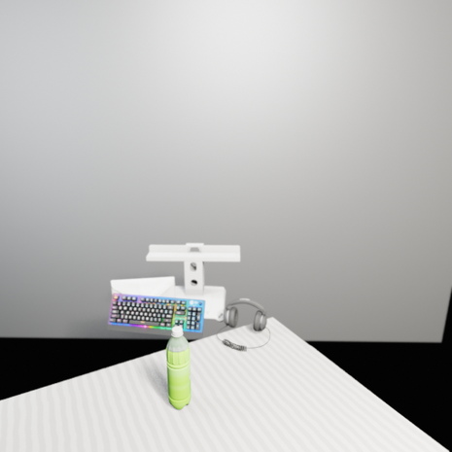
2026-02-10 — SAM3D+Meshy Static Scene Run 1 — Rounds (page 1)
R2
R5
R6
R8
R10
R11

Slide 14
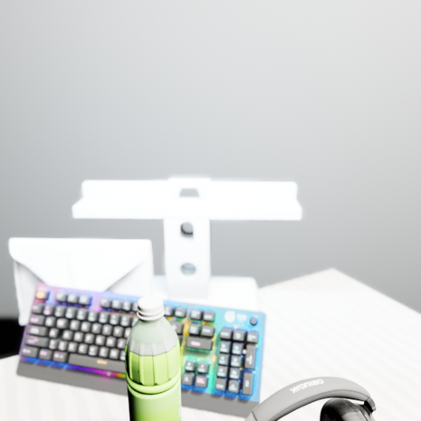
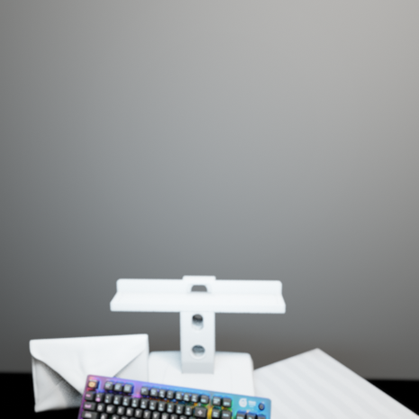
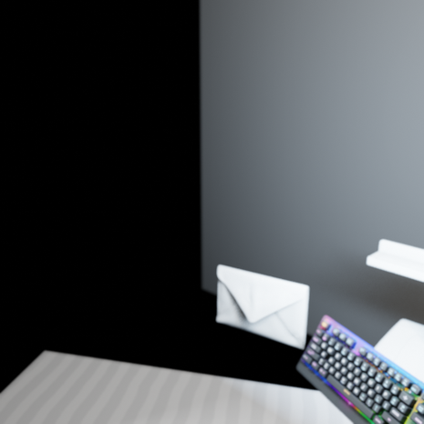
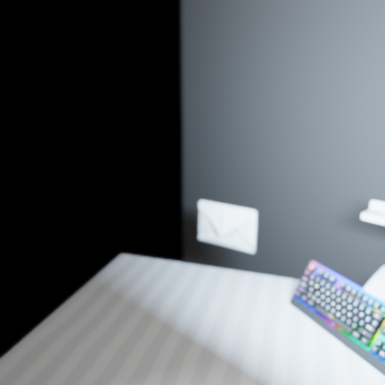

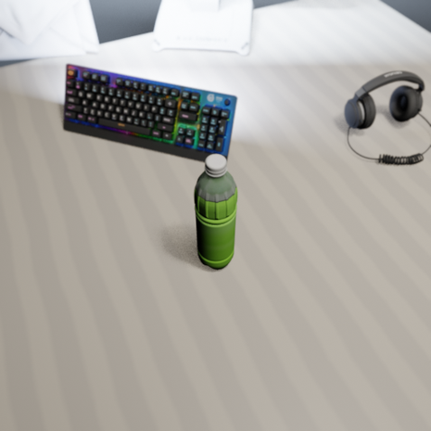
2026-02-10 — SAM3D+Meshy Static Scene Run 1 — Rounds (page 2)
R12
R13
R14
R15
R16
R17 Final

Slide 15
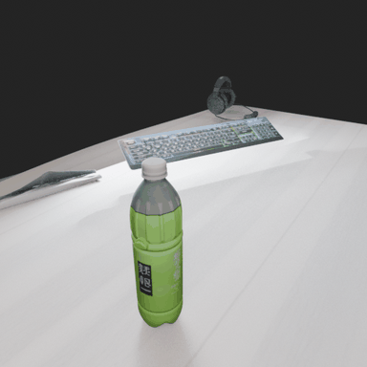
2026-02-09 — Static Scene: Green Tea Run 11
kingyy (win/vscode/opus/hum) | Run
19 rounds with AABB collision avoidance and non-uniform table scaling. Bottle Japanese label text visible by round 11. Cached Meshy assets.
Input / Target
Output / Result

Slide 16
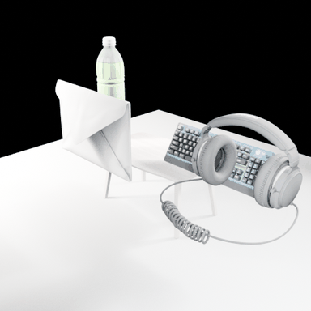
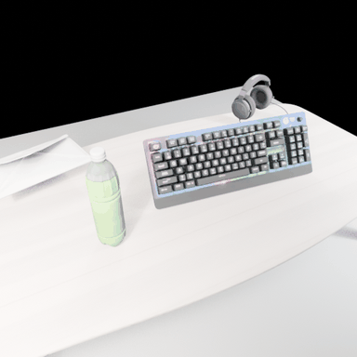
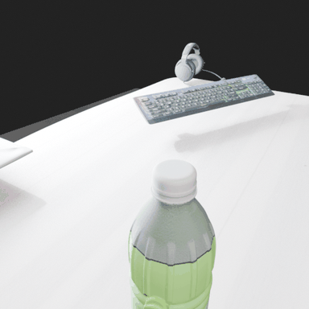
2026-02-09 — Static Scene: Green Tea Run 11 — Rounds
R1
R3
R13
R19 Final

Slide 17
2026-02-09 — Static Scene: Green Tea Run 10
kingyy (win/vscode/opus/hum) | Run
19 rounds. Night-desk aesthetic with blue monitor glow. Introduced orient_group_min_z() rotation helper for finding flattest object orientation. Cached Meshy assets.
Input / Target
Output / Result

Slide 18
2026-02-08 — Asset Pipeline Root Cause (Run 4)
kingyy (win/vscode/opus/hum) | Analysis
Root cause analysis: GLB imports failed silently due to relative path resolution in Blender. Fix: meshy_api.py resolves to absolute paths with forward slashes.
Problem: Blender CWD != project root -> relative GLB paths fail silently
All 5 get_better_object calls returned valid paths but Blender couldn't find files
Generator fell back to procedural geometry for all objects
Fix in meshy_api.py: Path(previous_assets_dir).resolve() with forward slashes
Fix in prompts: instructions to use EXACT absolute file paths
Verified: Run 5 successfully imports all GLB assets after fix

Slide 19


2026-02-08 — Asset Pipeline Root Cause (Run 4) (1/3)
R4 (GLB import failed)
R8 (procedural fallback)

Slide 20
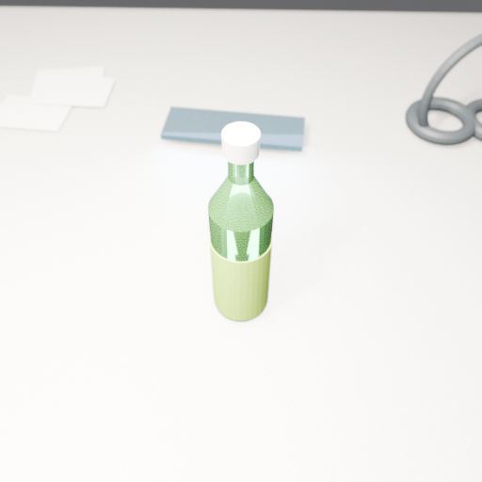
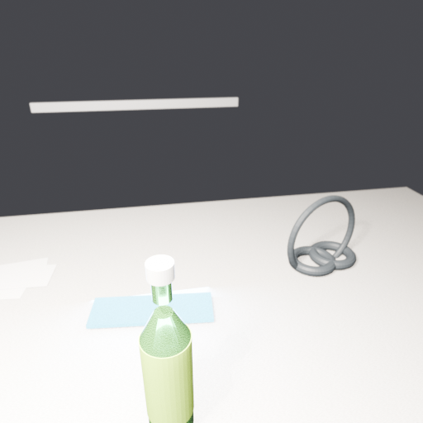
2026-02-08 — Asset Pipeline Root Cause (Run 4) (2/3)
R13
R16

Slide 21
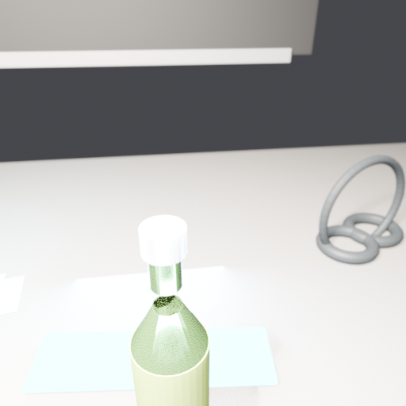
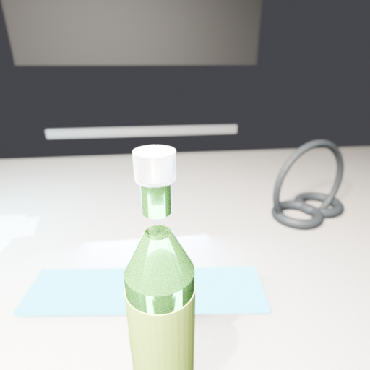
2026-02-08 — Asset Pipeline Root Cause (Run 4) (3/3)
R18
R19 Final

Slide 22
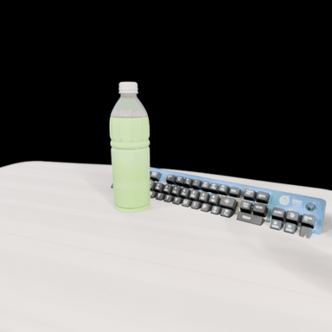
2026-02-08 — Static Scene: Green Tea Run 9 (Meshy API)
kingyy (win/vscode/opus/hum) | Run
First run with Meshy API text-to-3D for all 5 assets. Dramatically higher quality than SAM3D: recognizable PET bottle, RGB keyboard, headphones. Cinematic hero shot.
Input / Target
Output / Result

Slide 23
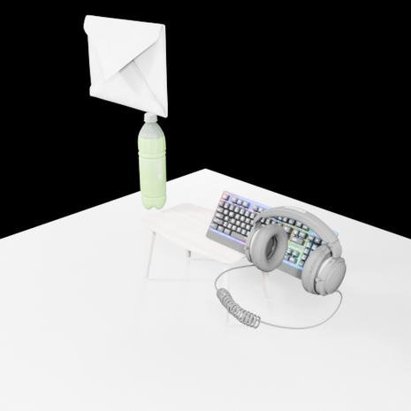
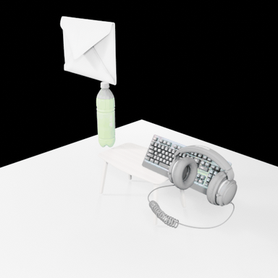
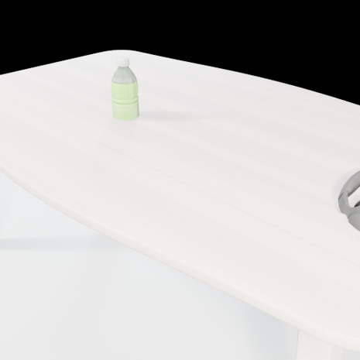
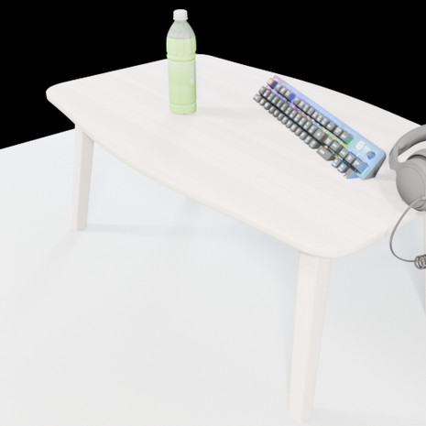
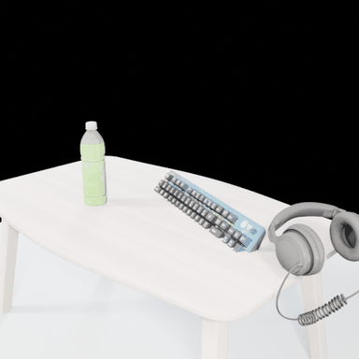
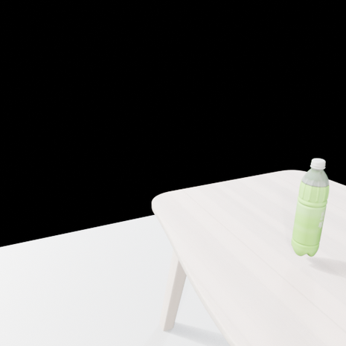
2026-02-08 — Static Scene: Green Tea Run 9 (Meshy API) — Rounds (page 1)
R3
R3 (360)
R4
R5
R5 (360)
R6

Slide 24


2026-02-08 — Static Scene: Green Tea Run 9 (Meshy API) — Rounds (page 2)
R7
R8 Final
R8 Final (360)

Slide 25

2026-02-08 — Static Scene: Green Tea Run 8
kingyy (win/vscode/opus/hum) | Run
First run with Meshy API key configured (but never called — all 5 assets matched locally). Slight regression in R6 (objects lost from camera view).
Input / Target
Output / Result

Slide 26






2026-02-08 — Static Scene: Green Tea Run 8 — Rounds (page 1)
R2
R2 (360)
R4
R5
R5 (360)
R6 Regression

Slide 27


2026-02-08 — Static Scene: Green Tea Run 8 — Rounds (page 2)
R8
R9 Final
R9 Final (360)

Slide 28

2026-02-08 — Static Scene: Green Tea Run 7 (get_asset_simple)
kingyy (win/vscode/opus/hum) | Run
New prompt setting forbids procedural geometry — only GLB imports allowed. All 5 SAM3D assets loaded and arranged over 9 rounds. Zero procedural violations.
Input / Target
Output / Result

Slide 29






2026-02-08 — Static Scene: Green Tea Run 7 (get_asset_simple) — Rounds (page 1)
R1
R1 (360)
R2
R3
R3 (360)
R4

Slide 30





2026-02-08 — Static Scene: Green Tea Run 7 (get_asset_simple) — Rounds (page 2)
R5
R6
R6 (360)
R8
R9 Final
R9 Final (360)

Slide 31

2026-02-08 — Static Scene: Green Tea Run 5 (First GLB Import)
kingyy (win/vscode/opus/hum) | Run
First run where absolute path fix enabled successful GLB asset imports. 25 rounds, 14 renders. Progression from overexposed early renders to full scene.
Input / Target
Output / Result

Slide 32





2026-02-08 — Static Scene: Green Tea Run 5 (First GLB Import) — Rounds (page 1)
R3
R5
R7
R9
R11
R14

Slide 33





2026-02-08 — Static Scene: Green Tea Run 5 (First GLB Import) — Rounds (page 2)
R16
R17
R19
R20 Final
CYCLES Final

Slide 34

2026-02-07 — Static Scene: Green Tea First Run (58 rounds)
kingyy (win/vscode/opus/hum) | Run
First static scene run with --prompt-setting=none. 58 scripts, 36 renders, ~4 hours. No GLB assets (MeshyAPI init failed). Severe scene drift after round 25.
Input / Target
Output / Result

Slide 35






2026-02-07 — Static Scene: Green Tea First Run (58 rounds) — Rounds (page 1)
R7
R9
R13
R16
R19
R23

Slide 36






2026-02-07 — Static Scene: Green Tea First Run (58 rounds) — Rounds (page 2)
R25
R28
R30
R36
R42
R44

Slide 37






2026-02-07 — Static Scene: Green Tea First Run (58 rounds) — Rounds (page 3)
R47
R50
R52
R55
R57
R58 Final

Slide 38

2026-02-07 — Static Scene: Green Tea First Run (58 rounds) — Rounds (page 4)
CYCLES Final

Slide 39
2026-02-06 — Windows Compatibility Fixes
kingyy (win/vscode/opus/hum) | Analysis
Four major Windows issues identified and fixed when running VIGA dynamic scene pipeline.
Issue 1: Blender path resolution
Blender resolves relative paths to its own CWD, not project root
Fix: .resolve() all Path objects before passing to Blender
Issue 2: Windows path spaces
Blender.exe path has spaces: 'C:\Program Files\Blender Foundation\...'
Fix: quote subprocess args containing spaces
Issue 3: Subprocess pipe deadlock
capture_output=True deadlocks on Windows with large outputs
Fix: use temp files for stdout/stderr instead of pipes
Issue 4: cp1252 encoding
Windows defaults to cp1252, but scripts contain UTF-8 characters
Fix: always specify encoding='utf-8' for file operations
Files fixed: exec.py, investigator_core.py, generator.py, verifier.py, common.py

Slide 40

2026-02-06 — Dynamic Scene: Artist Baseline
kingyy (win/vscode/opus/hum) | Run
First dynamic scene on Windows with GPT-5. Cezanne still life. Procedural geometry only (no SAM3D/Meshy). 12 rounds with physics-based ball-throwing animation.
Input / Target
Output / Result

Slide 41






2026-02-06 — Dynamic Scene: Artist Baseline — Rounds (page 1)
R2
R5
R7
R9 (360)
R9 Frame 1
R9 Frame 90

Slide 42





2026-02-06 — Dynamic Scene: Artist Baseline — Rounds (page 2)
R9 Frame 180
R11
R12 Final (360)
R12 Frame 1
R12 Frame 100
R12 Frame 200

Slide 43
2026-02-05 — SAM3D Pipeline Complete (5/5 Objects)
Yuna (win/claude/opus/clawdbot) | Summary
End-to-end SAM + SAM3D pipeline completed. 100% success (5/5 objects) on green tea scene. SAM segmentation -> mask extraction -> SAM3D reconstruction -> GLB export. ~2 hrs on RTX 5080.
Full pipeline: target.png -> SAM masks -> SAM3D 3D meshes -> GLB export -> Blender render -> GIF
5 objects: green tea bottle, Ito En bottle, keyboard, headphones, envelope
All objects successfully reconstructed with vertex colors
Both X-axis and Y-axis rotation GIFs generated per object
WebGL viewer integration for interactive 3D preview
Total processing: ~2 hours on NVIDIA RTX 5080 (16GB VRAM)

Slide 44


2026-02-05 — SAM3D Pipeline Complete (5/5 Objects) (1/3)
Input Scene
Green Tea Bottle

Slide 45


2026-02-05 — SAM3D Pipeline Complete (5/5 Objects) (2/3)
Ito En Bottle
Alienware Keyboard

Slide 46


2026-02-05 — SAM3D Pipeline Complete (5/5 Objects) (3/3)
Headphones
Envelope

Slide 47
2026-02-04 — SAM Segmentation Results
Yuna (win/claude/opus/clawdbot) | Summary
SAM segmented green tea desktop scene: 145 raw masks filtered to 8, identifying 5 objects.
Input: green tea desktop photograph
SAM produced 145 raw masks, filtered to 8 high-confidence regions
5 objects identified: green tea bottle, Ito En bottle, Alienware keyboard, headphones, envelope
Mask quality: clean edges, proper object boundaries
Ready for SAM3D batch 3D reconstruction

Slide 48

2026-02-04 — SAM Segmentation Results (1/3)
Target Scene
Green Tea Bottle Mask

Slide 49


2026-02-04 — SAM Segmentation Results (2/3)
Ito En Bottle Mask
Keyboard Mask

Slide 50


2026-02-04 — SAM Segmentation Results (3/3)
Headphones Mask
Envelope Mask

Slide 51
2026-02-04 — SAM3D All-Masks Results
Yuna (win/claude/opus/clawdbot) | Summary
SAM3D all-masks pipeline: 6 objects reconstructed with X and Y rotation GIFs.
6 objects: green tea bottle, Ito En bottle, bottle cap, label wrap, bottle neck, headphones
Both X-axis and Y-axis rotation GIFs generated for each object
Unexpected sub-object detection (bottle cap, label wrap, neck)
GLB generation statistics and mask coverage analysis

Slide 52

2026-02-04 — SAM3D All-Masks Results (1/3)
Input
Green Tea Bottle

Slide 53


2026-02-04 — SAM3D All-Masks Results (2/3)
Ito En Bottle
Bottle Cap

Slide 54


2026-02-04 — SAM3D All-Masks Results (3/3)
Label Wrap
Headphones

Slide 55
2026-02-04 — SAM3D AllMasks Test Investigation
Yuna (win/claude/opus/clawdbot) | Analysis
4 rounds of mask quality investigation. Direct pipeline test failed (missing open3d). Discovered mask format issue and reassessed quality metrics.
Round 1: Direct SAM3D pipeline test failed (missing open3d dependency)
Round 2: VIGA architecture discovery during debugging
Round 3: Mask quality analysis with black-and-white visualization
Round 4: Corrected quality reassessment — initial misjudgment about coverage metrics
Key finding: mask format must be binary (0/1), not grayscale (0/255)

Slide 56

2026-02-04 — SAM3D AllMasks Test Investigation
Mask Comparison

Slide 57
2026-02-04 — SAM3D Rotation Optimization
Yuna (win/claude/opus/clawdbot) | Analysis
Quaternion vs Euler rotation for rendering SAM3D GLBs in Blender. Quaternion rotation avoids gimbal lock.
Problem: Euler rotation causes gimbal lock at certain angles
Solution: quaternion rotation for smooth 360-degree renders
Test object: Ito En green tea bottle
Generated X-axis and Y-axis rotation GIFs + frame samples
Quaternion rotation integrated into blender_render_rotation.py

Slide 58


2026-02-04 — SAM3D Rotation Optimization (1/3)
SAM Input
X-Rotation

Slide 59

2026-02-04 — SAM3D Rotation Optimization (2/3)
Y-Rotation
X Frame 0

Slide 60

2026-02-04 — SAM3D Rotation Optimization (3/3)
Y Frame 0
Y Frame 15

Slide 61
2026-02-03 — SAM3D WSL Experience Summary
Arin (wsl/claude/opus/clawdbot) | Summary
Consolidated findings from SAM3D testing on WSL2 Ubuntu.
Small images (<=1024px) work on RTX 5080 16GB VRAM
Large images (>1024px) cause OOM at Stage 3 decode
Mesh generation must be skipped (Gaussian-only mode)
Critical discovery: mask format must be 0/1, NOT 0/255

Slide 62
2026-02-03 — SAM3D WSL Experience Summary
Arin (wsl/claude/opus/clawdbot) | Summary (cont.)
WSL ~30% faster than Windows for SAM3D inference
VRAM efficiency better in WSL (less OS overhead)
Recommendation: use Windows native for most tasks
WSL useful for batch processing with lower VRAM pressure

Slide 63
2026-02-03 — Debug: Flat Mesh Issue
Yuna (win/claude/opus/clawdbot) | Analysis
Root cause: SAM3D produced flat table shape instead of bottle. Wrong input image used (inverted mask showing table background with bottle cut out).
Symptom: SAM3D output was a flat table-shaped mesh instead of a bottle
Investigation: compared correct vs incorrect input images
Root cause: inverted mask — table background passed instead of bottle foreground
SAM3D correctly reconstructed what it was given (table shape)
Fix: use original segmentation mask, not its inverse

Slide 64

2026-02-03 — Debug: Flat Mesh Issue (1/2)
Wrong Input (inverted mask)
Flat Mesh Result

Slide 65

2026-02-03 — Debug: Flat Mesh Issue (2/2)
Correct Input
Correct Result

Slide 66
2026-02-03 — VIGA Workflow: SAM3D Call
Yuna (win/claude/opus/clawdbot) | Analysis
Complete SAM3D call from image to 3D mesh. Documents pipeline workflow, output JSON, mesh structure (flat 'billboard' mesh problem), and disabled mesh post-processing root cause.
Documented complete SAM3D inference call chain
Output JSON includes transform data (translation, rotation, scale)
Mesh analysis revealed flat 'billboard' geometry
Root cause: mesh post-processing was disabled in pipeline config
Fix: enable mesh post-processing in pipeline.yaml

Slide 67
2026-02-03 — VIGA Workflow: SAM3D Call
Input Scene
Flat Mesh Render

Slide 68
2026-02-03 — VIGA Architecture Reference
Sohee (win/antigravity/gemini-pro-high/clawdbot) | Analysis
Technical reference: VIGA -> SAM3D -> TRELLIS hierarchy, inference pipeline stages, dual decoder architecture, VRAM distribution, and optimization configs.
Three-tier hierarchy: VIGA (orchestrator) -> SAM3D (reconstruction) -> TRELLIS (core model)
VIGA: dual-agent system — Generator writes Blender Python, Verifier evaluates renders
SAM3D: Meta SAM segmentation -> TRELLIS 3D reconstruction per mask
TRELLIS: sparse structure generation -> dual decoder (Gaussian Splatting + Mesh)
VRAM budget: ~14GB peak on RTX 5080 (16GB available)
Optimization: half precision, gradient checkpointing, batch size tuning

Slide 69
2026-02-03 — SAM3D Internals Deep Dive
Yuna (win/claude/opus/clawdbot) | Analysis
Technical investigation of SAM3D/TRELLIS pipeline internals. 4 stages, tunable parameters, and VRAM optimization strategies.
Stage 1 (Preprocess): image resize, normalization, feature extraction
Stage 2 (Sparse Structure): voxel grid generation, sparse 3D structure
Stage 3 (Sparse Latent): latent code generation from sparse structure
Stage 4 (Decode): dual decoder — Gaussian Splatting + Mesh extraction
Tunable params: seed, guidance_strength, sampling_steps
num_gaussians cannot be changed at runtime (hardcoded in model)
Decode is the bottleneck (~60% of total inference time)
VRAM optimization: half precision saves ~3GB, gradient checkpointing saves ~2GB

Slide 70
2026-02-03 — SAM3D Tools Reference
Yuna (win/claude/opus/clawdbot) | Analysis
CLI tools for the SAM3D workflow: inference, visualization, rendering, and GIF creation.
sam3d_worker.py: main inference script (image + mask -> GLB)
downsample_pointcloud.py: reduce vertex count for large meshes
render_pointcloud.py: visualize 3D point clouds in Blender
blender_render_rotation.py: generate 360-degree rotation renders
create_gifs.py: assemble rendered frames into animated GIFs
Complete workflow: segment -> reconstruct -> render -> GIF

Slide 71


2026-02-03 — SAM3D Bottle Test (Windows)
Yuna (win/claude/opus/clawdbot) | Run
Successful SAM3D bottle reconstruction. Single green tea bottle -> 379K-vertex 3D mesh (15MB GLB) in ~9 minutes on RTX 5080. Proper geometry and vertex colors confirmed.
Input / Target
Output / Result

Slide 72

2026-02-03 — SAM3D Windows Native Test
Yuna (win/claude/opus/clawdbot) | Run
First SAM3D on Windows 11. Single-image to 3D mesh generation. Windows outperformed WSL for SAM3D inference speed.
Input / Target
Output / Result

Slide 73


2026-02-01 — SAM3D WSL Testing (3 Attempts)
Arin (wsl/claude/opus/clawdbot) | Run
SAM3D on WSL2 Ubuntu. Three test attempts (original 4480x6720, stage-1-only, 1080p scaled). All failed at Stage 3 decode due to OOM on 16GB VRAM.
Input / Target
Output / Result

Slide 74
2026-01-30 — VIGA Progress: SAM3D Environment Setup
Yuna (win/claude/opus/clawdbot) | Summary
SAM3D environment setup for RTX 5080 (Blackwell sm_120). Critical dependency discovery.
RTX 5080 (sm_120 Blackwell) requires Kaolin 0.18.0
PyTorch 2.8.0 minimum for Blackwell GPU support
Three conda environments tested:
sam3d: original (incompatible with Blackwell)
sam3d_viga: attempted fix (still incompatible)

Slide 75
2026-01-30 — VIGA Progress: SAM3D Environment Setup
Yuna (win/claude/opus/clawdbot) | Summary (cont.)
sam3d_kaolin: working (Kaolin 0.18.0 + PyTorch 2.8.0)
Recommended setup: sam3d_kaolin environment
Successfully imported all SAM3D dependencies
Next step: run SAM3D inference on test images

Slide 76
2026-01-29 — VIGA Workflow Reference
Sohee (win/antigravity/gemini-pro-high/clawdbot) | Analysis
Comprehensive workflow reference: 5 pipeline modes, dual-agent architecture, supported VLMs, 3D tools, and project structure.
5 pipeline modes: dynamic_scene, static_scene, BlenderGym, BlenderBench, SlideBench
Dual-agent: Generator (writes Blender Python) + Verifier (evaluates renders)
MCP tool servers for Blender execution and asset management
Supported VLMs: GPT-4o, GPT-5, Claude
3D tools: Meshy (text-to-3D), SAM3D (image-to-3D), Infinigen (procedural)
Iterative loop: generate -> render -> verify -> feedback -> repeat

Slide 77
2026-01-29 — VIGA First Tests (Green Tea + Artist)
Yuna (win/claude/opus/clawdbot) | Run
Initial VIGA tests with GPT-4o. Two scenarios: (1) green tea bottle tipping over, (2) Cezanne still life destruction. Established dual-agent iterative workflow.
Input / Target
Output / Result

Slide 78




2026-01-29 — VIGA First Tests (Green Tea + Artist) — Rounds
Green Tea Input
Green Tea Output
Artist Input
Artist Output

Slide 79
VIGA Project Summary
31 docs | 14 days | SAM3D + Meshy + Blender + GPT-5
Yuna (win/claude/opus/clawdbot) | Arin (wsl/claude/opus/clawdbot) | kingyy (win/vscode/opus/hum) | Sohee (win/antigravity/gemini-pro-high/clawdbot)

